Slide 1


Slide 2
Part One:
The Revolution

Slide 3
Statistics
1.75 billion smartphones worldwide
Nearly half of consumers say they won’t return to a website if it doesn’t load properly on their mobile devices
Mobile internet searches are projected to exceed desktop searches in 2015
50.3% of ecommerce website traffic comes through mobile devices

Slide 4
Statistics
41% of smartphone owners have made a purchase from their mobile
60% of global consumers use their mobile device as their primary internet source
Consumers look at native mobile ads 25% more often than banner ads
On average, people are spending 1.8 hours a day on their mobiles

Slide 5
Statistics
SMS/text messages are 76% more likely to be read than emails
By 2018, mobile video will represent 69% of all mobile traffic, which is an increase from 53% in 2013
51% of Emails are opened on Mobile Devices – Smart Marketers BEWARE!

Slide 6
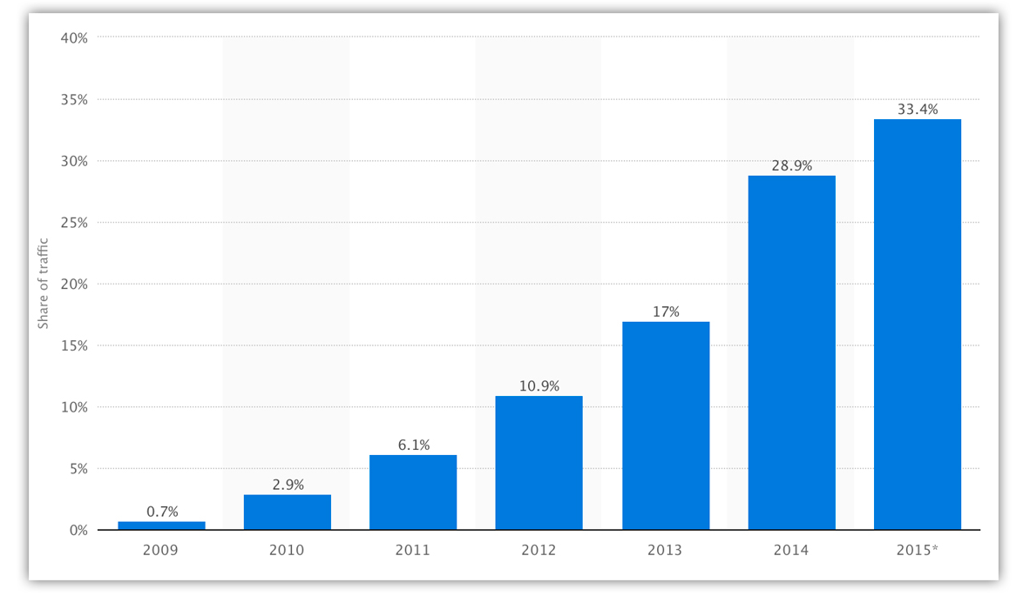
Mobile currently accounts for a third of all global web pages served – up 96% since 2013

Slide 7
Google’s Mobilegeddon
48% of searches are on mobile
Google wants the best experience for its users
April 2015 – Google made sweeping changes
Two months’ notice (unusual)
Only Mobile search results impacted
Desktop and Tablet results remain the same
To check your site, go to: www.google.com/webmaster/tools/mobile-friendly

Slide 8
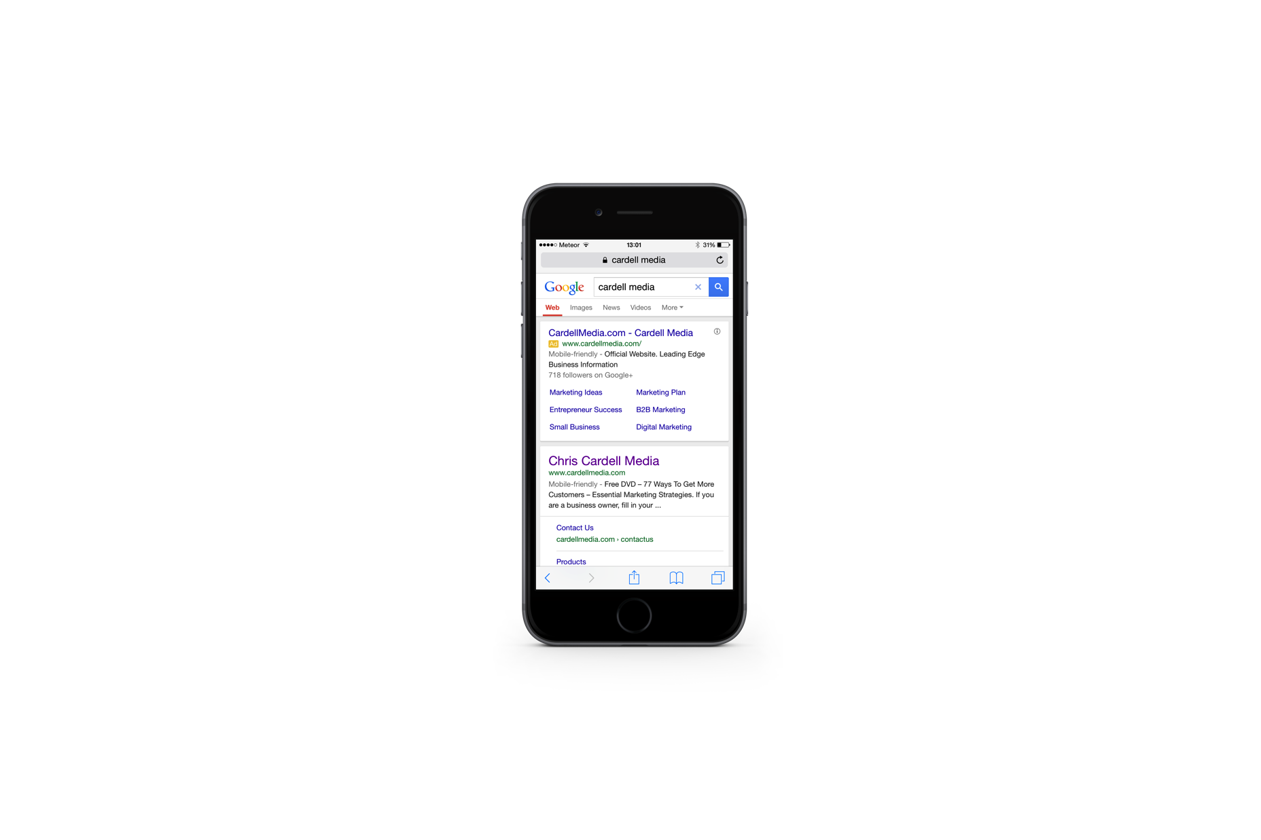
Mobilegeddon
‘Mobile-Friendly’ appears next to search results
Your site can still be updated - unlike previous algorithm updates, websites can upgrade their ‘mobile friendliness’ at any time to appear higher in the search results

Slide 9
Mobile: The Challenge
Lost sales
Lost leads
Lost customer engagement
Google search rankings
Order process
50% of your Business?

Slide 10
The Opportunity
Competitive Advantage
Mobile users are good Buyers
Great customer engagement
Huge numbers of new customers
Cheap!
Scalable for Smart Marketers
Ride the Wave!

Slide 11
What is ‘Mobile Friendly’?
Content is optimised to fill the screen – regardless of the screen size (iPhone, Android, etc.)
Buttons and links are easy to ‘tap’
Text/Font size is easy to read
Pages don’t require you to ‘pinch and zoom’ to view each element

Slide 12
What is ‘Mobile Friendly’?
Site navigation is easy and intuitive
Videos play across all devices
Contact forms are easy to complete

Slide 13
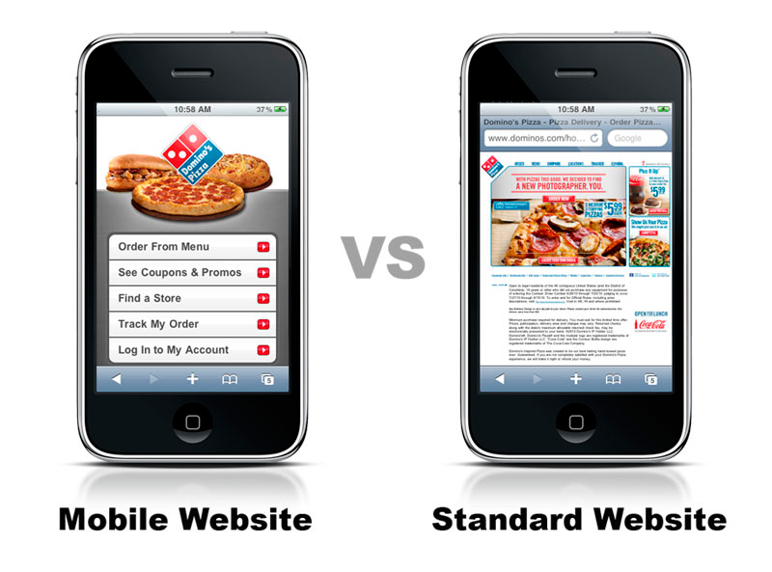
What is ‘Mobile Friendly’?

Slide 14
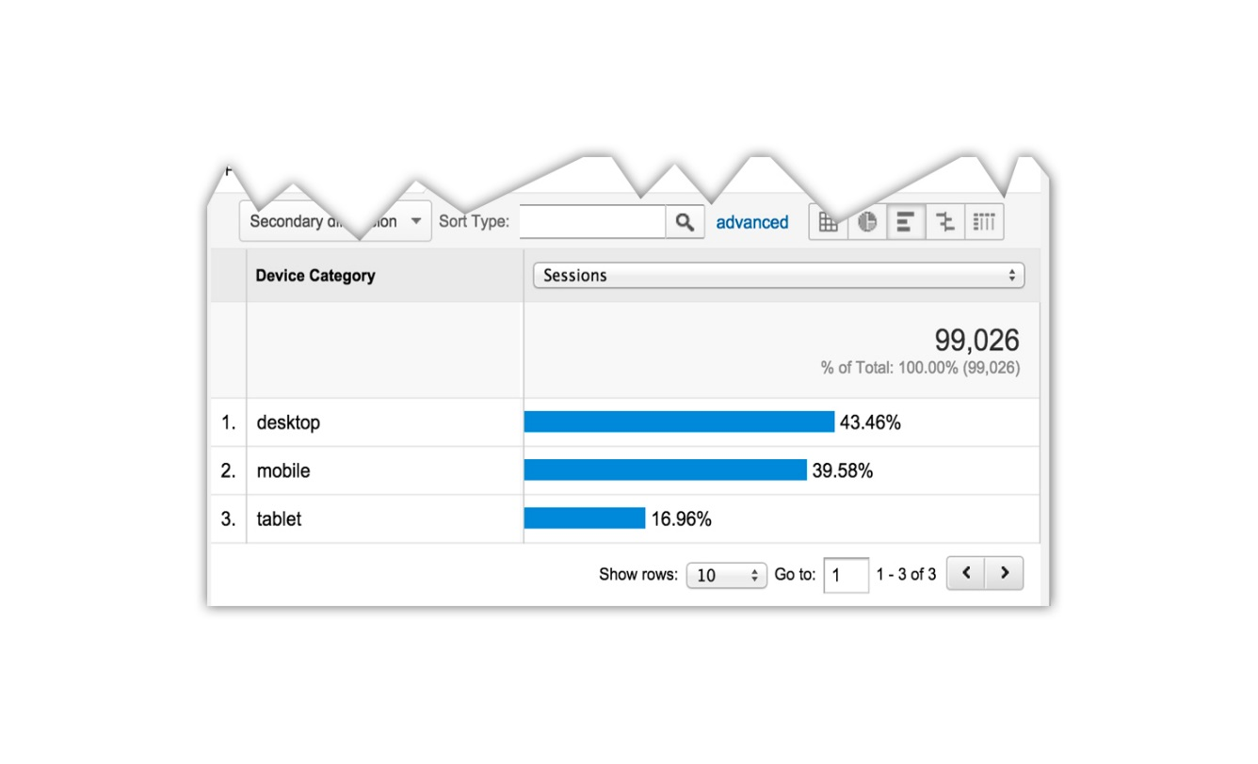
What is ‘Mobile Friendly’?
Your analytics will tell you what percentage of your site visitors are mobile
Tablets behave more like Desktops than Mobiles (e.g., a page that looks good on a Desktop will look ok on a Tablet, but NOT on a mobile)

Slide 15
How to Make
Your Website
Mobile Friendly

Slide 16
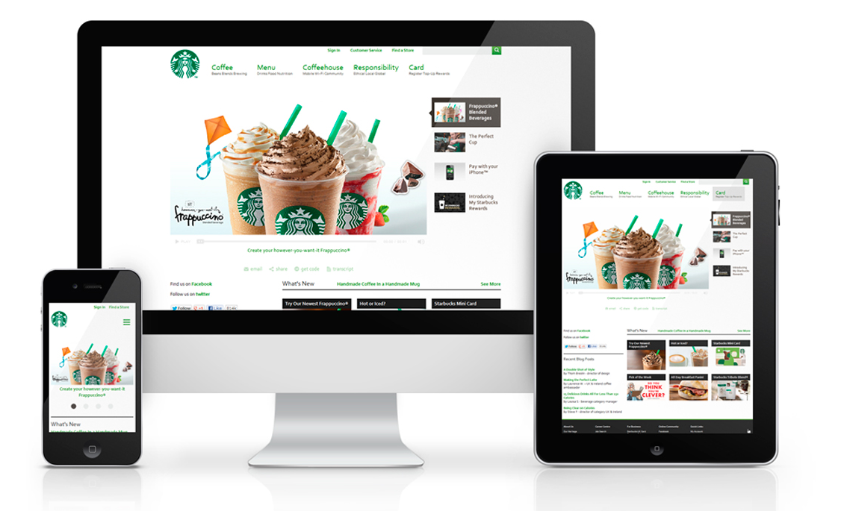
Option One: 'Responsive Websites'
'Responsive Websites' dynamically realign themselves to look good on any device; mobile, tablet or desktop. Headlines, text and pictures automatically scale and move around to fill the screen

Slide 17
Option One: 'Responsive Websites'
Pros of Responsive Web Design
Highly flexible - one website works on all devices, easy to maintain
This is Google's recommended configuration
Future proof - will comply with new browsers

Slide 18
Option One: 'Responsive Websites'
Cons of Responsive Web Design
Expensive upfront cost
Landing pages don't convert as well as
specific mobile optimised pages

Slide 19
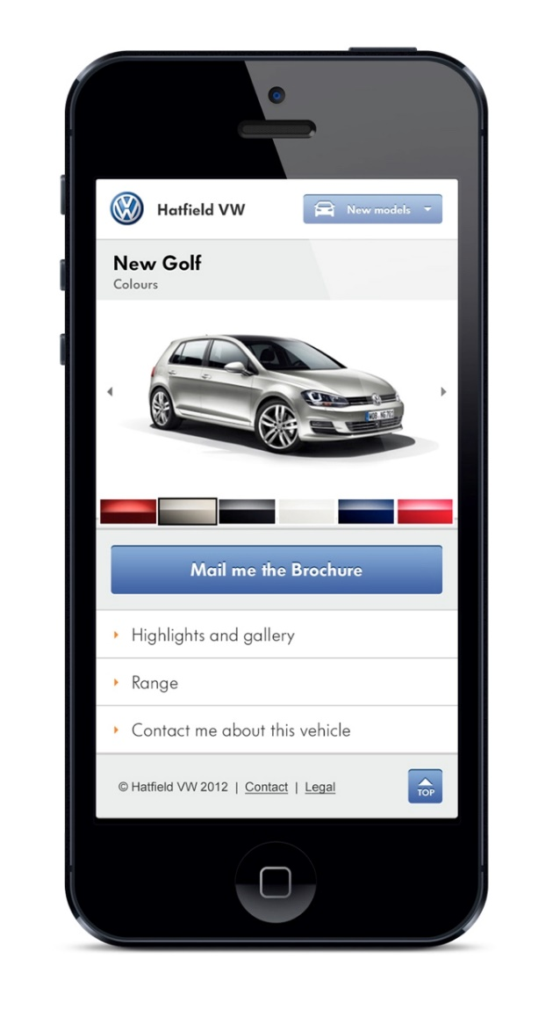
Option Two: ’Mobile Websites'
Mobile sites are built specifically for mobile devices. A piece of code on your main website detects mobile visitors and diverts them to your mobile site
Mobile sites can be put on a subdomain of your main site, e.g.,
www.mobile.cardellmedia.com

Slide 20
Option Two: ‘Mobile Websites'
Pros of Mobile Websites
Can be optimised specifically for mobile users
Is the most mobile-friendly option
Easier and cheaper to design/build

Slide 21
Option Two: ’Mobile Websites'
Cons of Mobile Websites
Recurring maintenance
Higher cost for updating content on
multiple pages
May need to updated to work with
future browsers

Slide 22
Responsive vs. Mobile: The Difference
Responsive sites work across any device
Mobile sites only work on mobile devices
Mobile sites look like apps

Slide 23

Responsive vs. Mobile: The Difference
Example: A restaurant could have their website turned into a ‘responsive’ site so mobile visitors see the same content as everyone else

Slide 24

Responsive vs. Mobile: The Difference
Or they could build a mobile-specific site like this:

Slide 25
Landing Pages

Slide 26

Your Landing Pages
Landing Pages must be ‘Responsive’
Drive traffic to mobile and tablet pages designed specifically for each device
Avoid 2-step opt-in overlays or exit
pop-ups, as these behave differently on mobile devices

Slide 27
Advice
The following all provide the ability to build mobile-specific landing pages:
www.unbounce.com
www.leadpages.net
www.clickfunnels.com
www.optimizepress.com

Slide 28
Mobile Videos

Slide 29

Video
Video behaves differently on mobile
Videos do not auto play

Slide 30
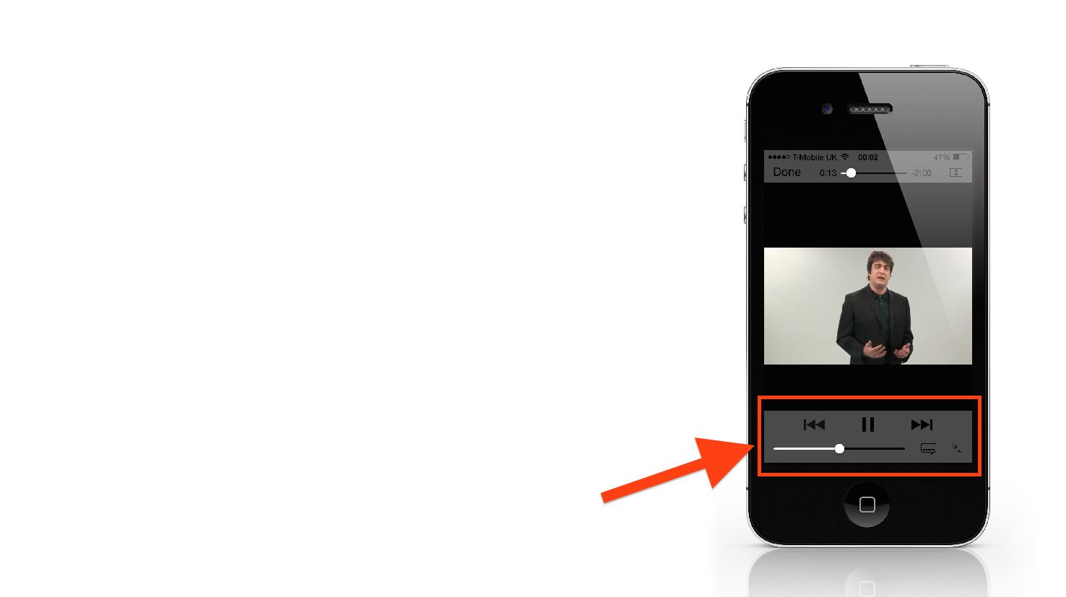
Video
You can’t hide the video control buttons (Play, Pause, etc.)

Slide 31
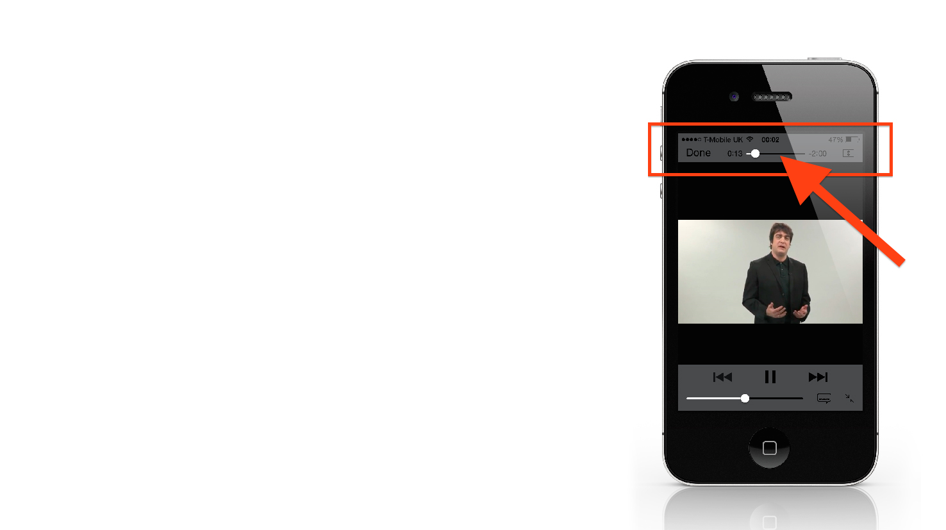
Video
You can’t hide the time / duration
On mobile, videos open in a ‘play screen’

Slide 32

Video
From our testing:
Treat mobile and tablets independently
One video for mobile, one for tablets
Use ‘click to play’ placeholder graphics

Slide 33
Video
From our testing:
On mobile use a ‘click done’ end screen
On tablets use a ‘call to action’ end screen
The inability to hide the play button / video length has not been an issue

Slide 34
Advice
Use www.wistia.com to create copies of your video for each device
Use www.canva.com or www.fiverr.com to create screen slides
Instruct people to click ‘done’ on your mobile videos to go back to your page

Slide 35
Action Steps
Ask Your Web Designer
What experience do they have with mobile web development?
Ask to see examples, and check them on your phone, iPad and desktop
If the site breaks, gets hacked or needs updating - what will they do?
Can design changes be added later?

Slide 36
Action Steps
Ask Your Web Designer
Do they build from scratch, or modify templates bought from template libraries?
Will they find/supply photos for your site?
Who owns the site when it's done?
Do they charge by the hour or by the project?

Slide 37
Action Steps
Price
It should take around 1 – 3 days to build a 1 – 10 page Mobile optimised site
It’s easier to build a fresh ‘responsive’ site from scratch – as opposed to 'updating’ an existing site
Price will go up depending on site complexity/requirements
Search for ‘mobile web design’ on Elance.com and Odesk.com

Slide 38
Part Two:
Mobile Marketing

Slide 39
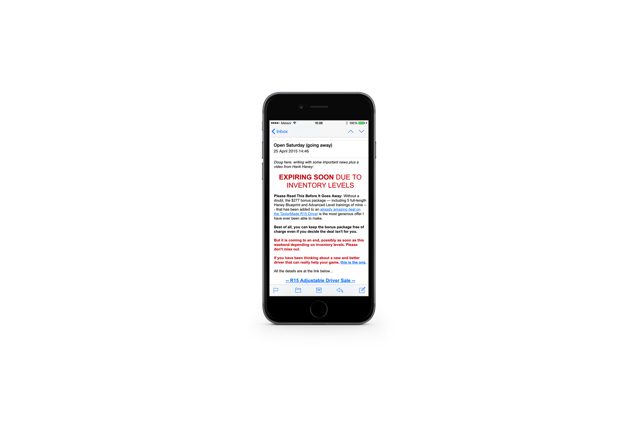
Emails
74% of smartphone users use their devices to check their emails
Mobile now makes up the majority of email opens at 51%
68% of Gmail and Yahoo opens come from mobile

Slide 40
Emails
By 2018, worldwide mobile email users are expected to total over 2.2 billion. With 80% of email users expected to access their email via a mobile device
Avoid the morning ‘email clean’
10am is Optimal Email time

Slide 41
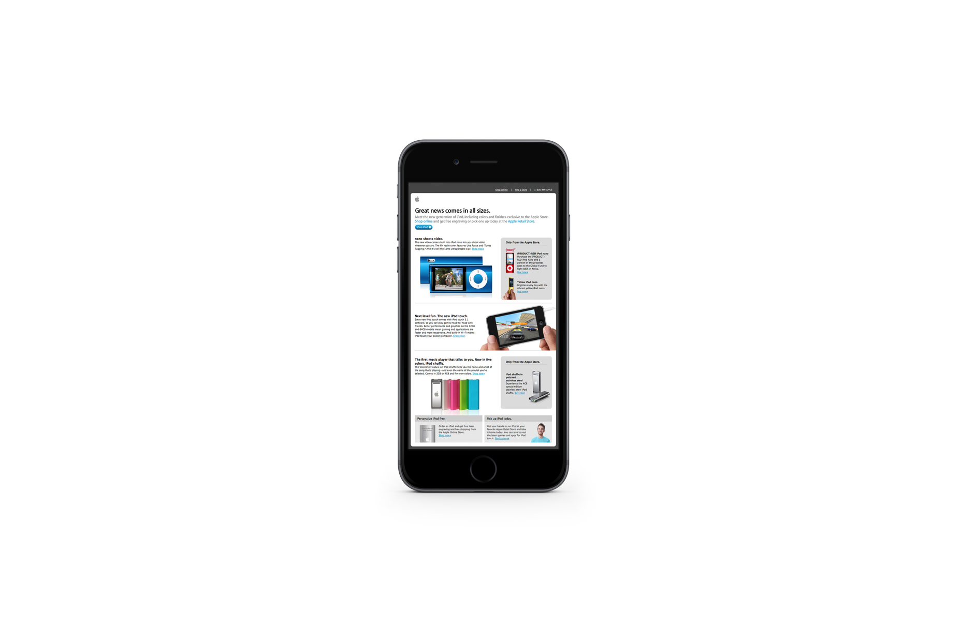
Email ‘Newsletters’
70% of consumers delete email newsletters that don’t render well on their mobile
Your email newsletters must be ‘responsive’
Only 11.84% of newsletters are mobile optimised
39% of marketers have no strategy for mobile email

Slide 42
Email ‘Newsletters’
Virtually all email service providers now provide the option to design mobile optimised newsletters
Over 95% of emails are only opened on one device. Very few users open emails on mobile first and save for desktop later

Slide 43
The Solution
Don’t send Email Newsletters!
Send normal, personalised text emails

Slide 44
The Email Mobile Opportunities
Emails directing users to a mobile friendly page
Referencing mobile friendly
Emails directing users to Video
Emails asking for a phone call

Slide 45


Slide 46

Facebook
1.9 Billion monthly mobile users
65% of video views are on mobile
30% of people will only visit Facebook on their mobile

Slide 47
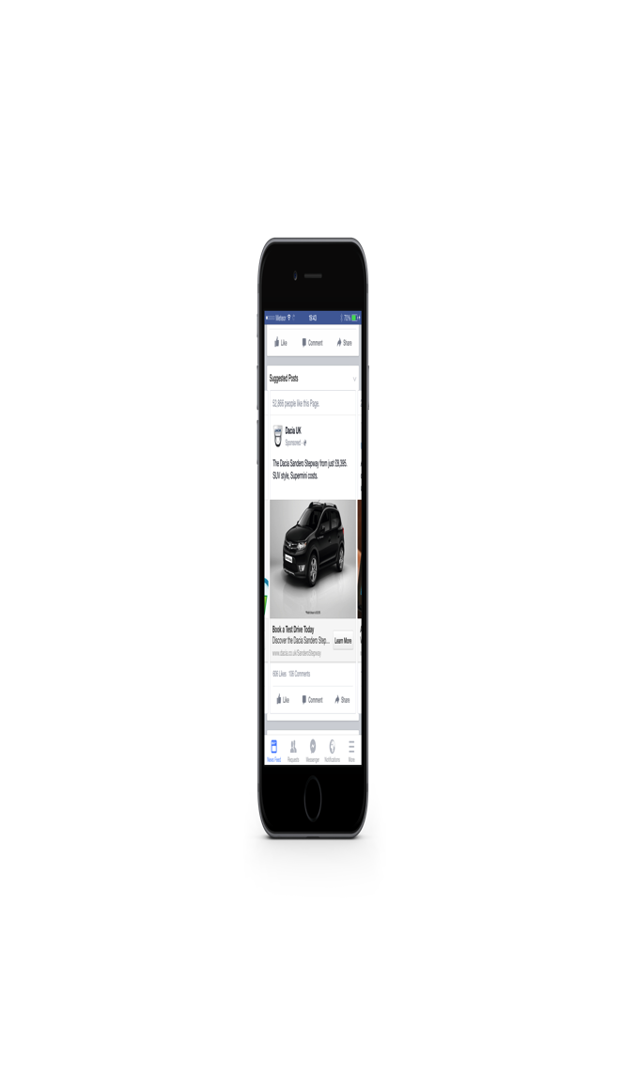
Facebook Mobile Tips
Separate Campaigns
Higher CTR
The regular ad builder will separate: Mobile/Desktop
Use the Power Editor to separate campaigns: Android phone, Android tablet, iPhone, iPod and iPad

Slide 48
Facebook Mobile Tips
Use the Power Editor to target Facebooks ‘Audience Network’ to put your ad on Apps outside of Facebook (doesn’t support video ads)
Drive mobile and tablets to separately optimised landing pages

Slide 49
Facebook Video Ads
Facebook is changing from a picture-based experience to a video-based experience
Very high engagement
Your video can be clicked on
Massive Reach
Captive Audience
People will watch long videos

Slide 50
Facebook Video Ads
People will buy
Very cheap traffic
Start with Facebook

Slide 51
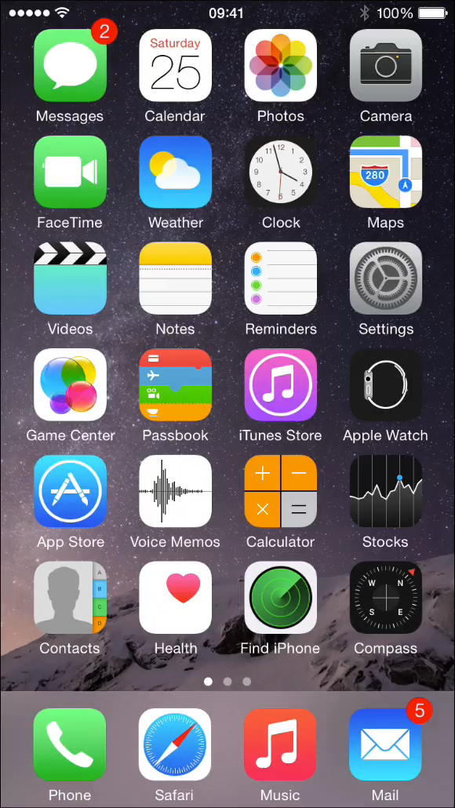
Facebook Video Ads
The Video appears in the news feed
Depending on user settings, the video may or may not auto play

Slide 52
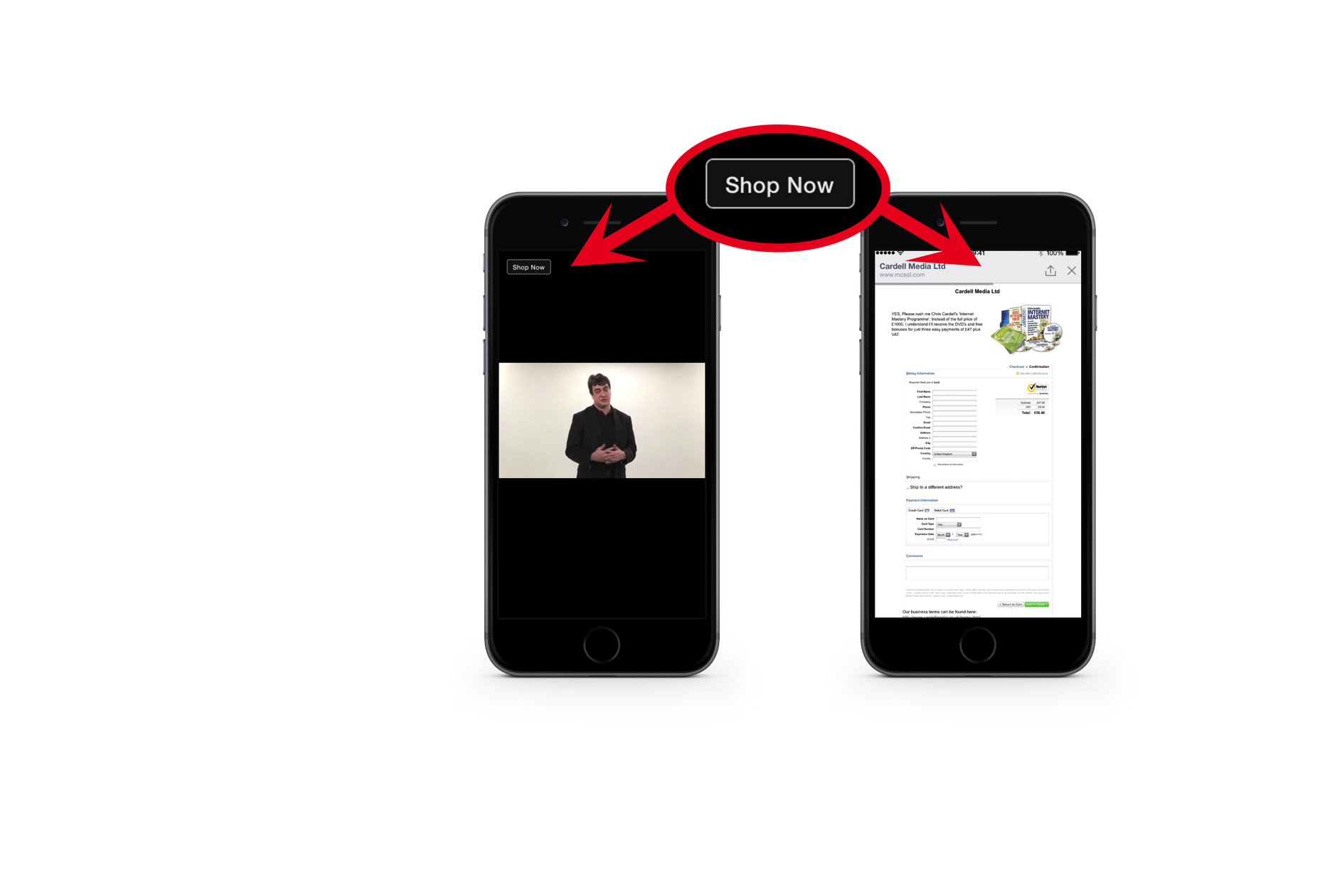
Facebook Video Ads
Clicking on the video activates the Call to Action button
Clicking the button will take you to your destination URL

Slide 53
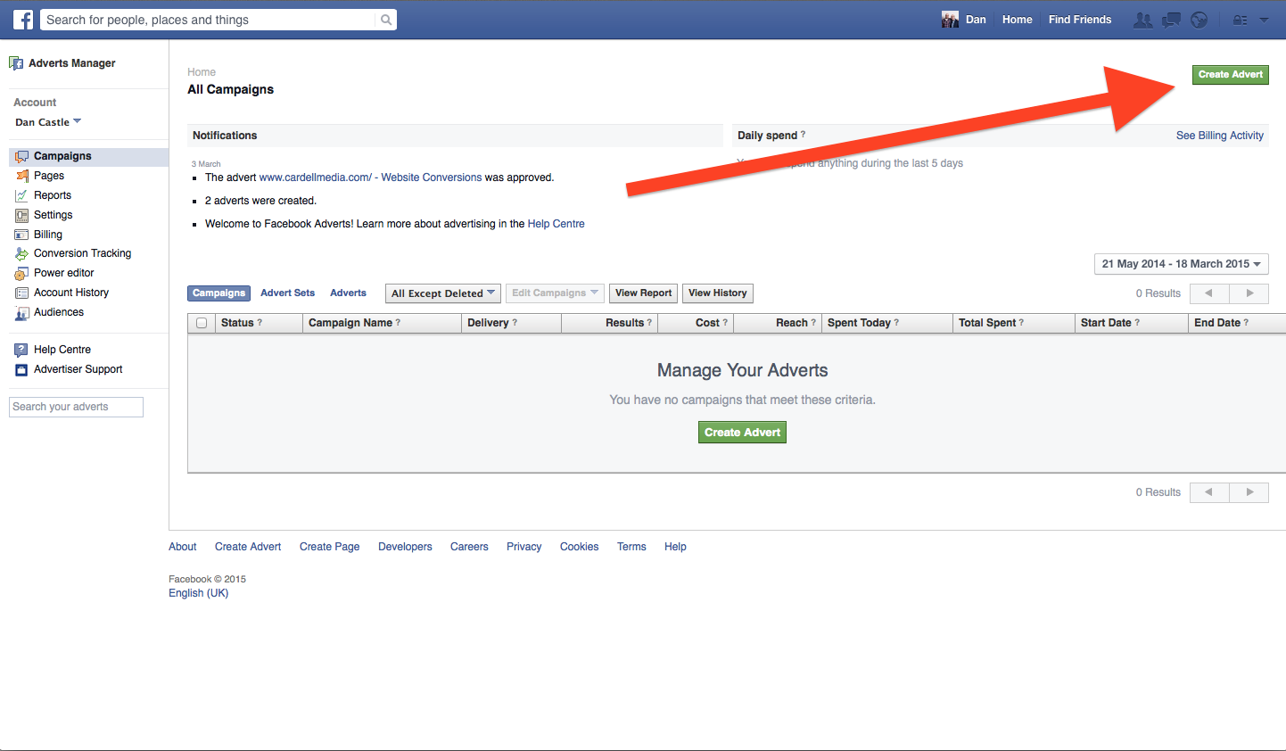
How to Create a Video Ad
Go to your Ad Manager and click Create Ad

Slide 54
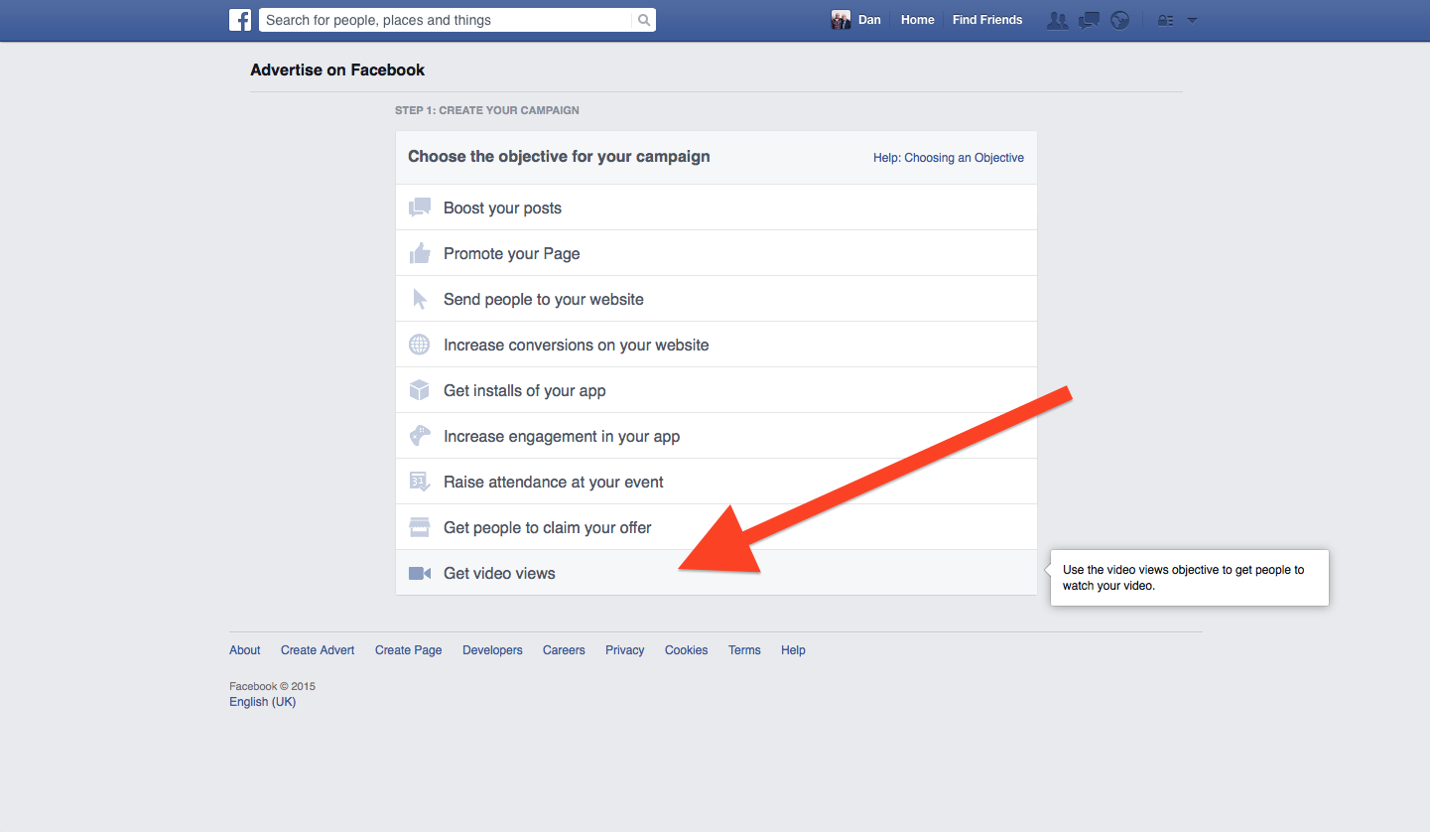
How to Create a Video Ad
Select Get
Video Views

Slide 55
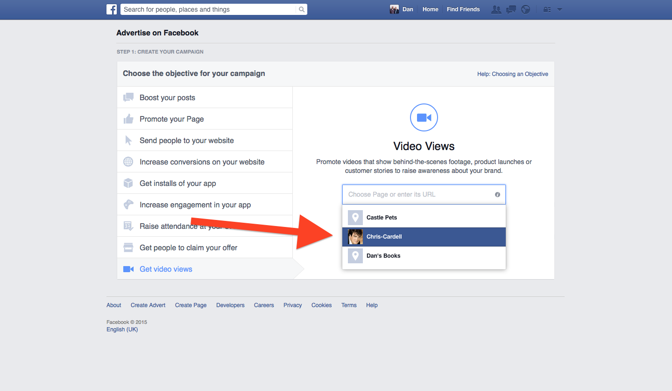
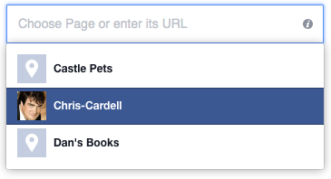
How to Create a Video Ad
Locate your Facebook Business Page from the drop-down menu

Slide 56
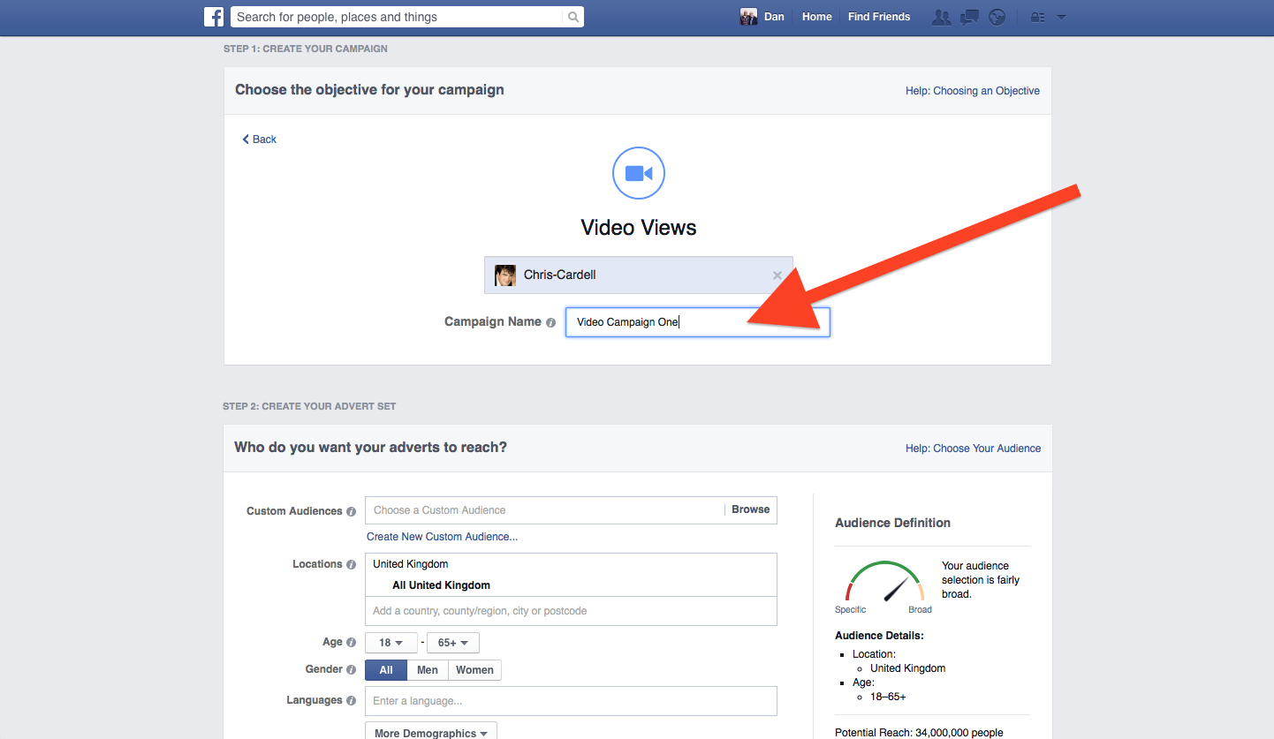

How to Create a Video Ad
Name your campaign

Slide 57
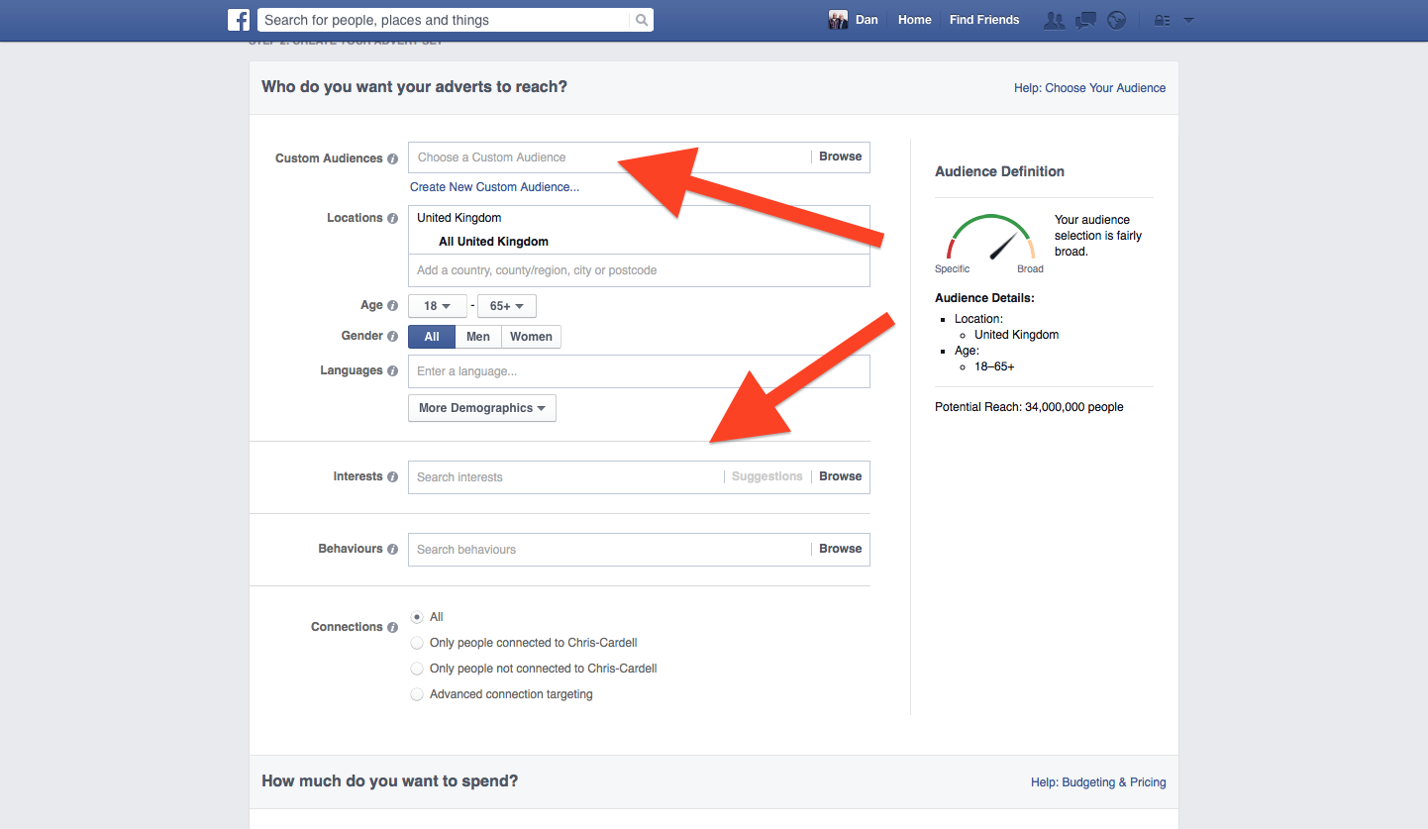
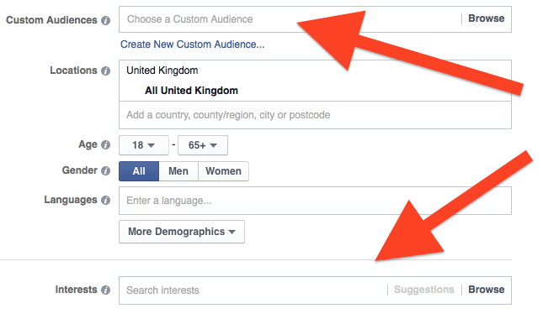
How to Create a Video Ad
Targeting
Select either a Custom Audience
Or a Lookalike Audience
Or use the Interests and Demographics options

Slide 58
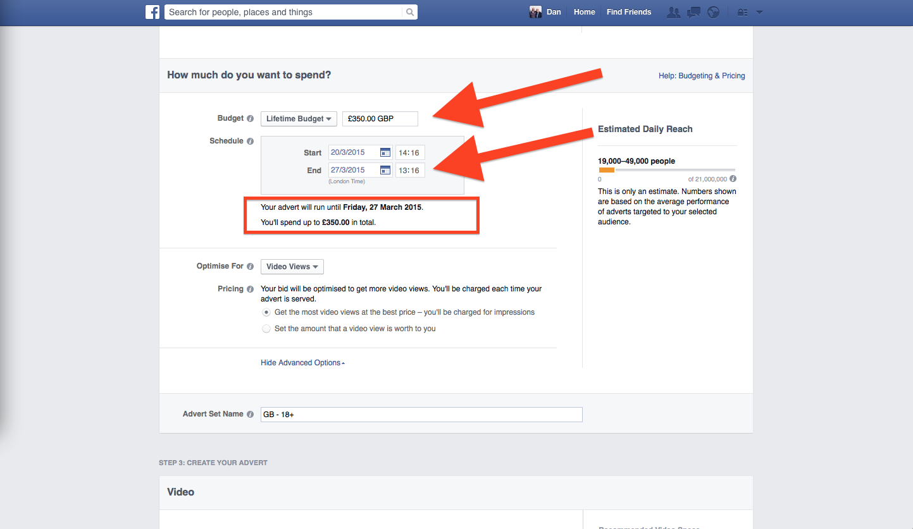
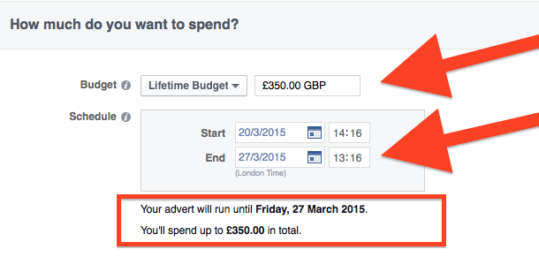
How to Create a Video Ad
Budgeting
Set a lifetime budget (e.g., £50 a day x 7 days = £350)
Then schedule your campaign to run for 1 week

Slide 59
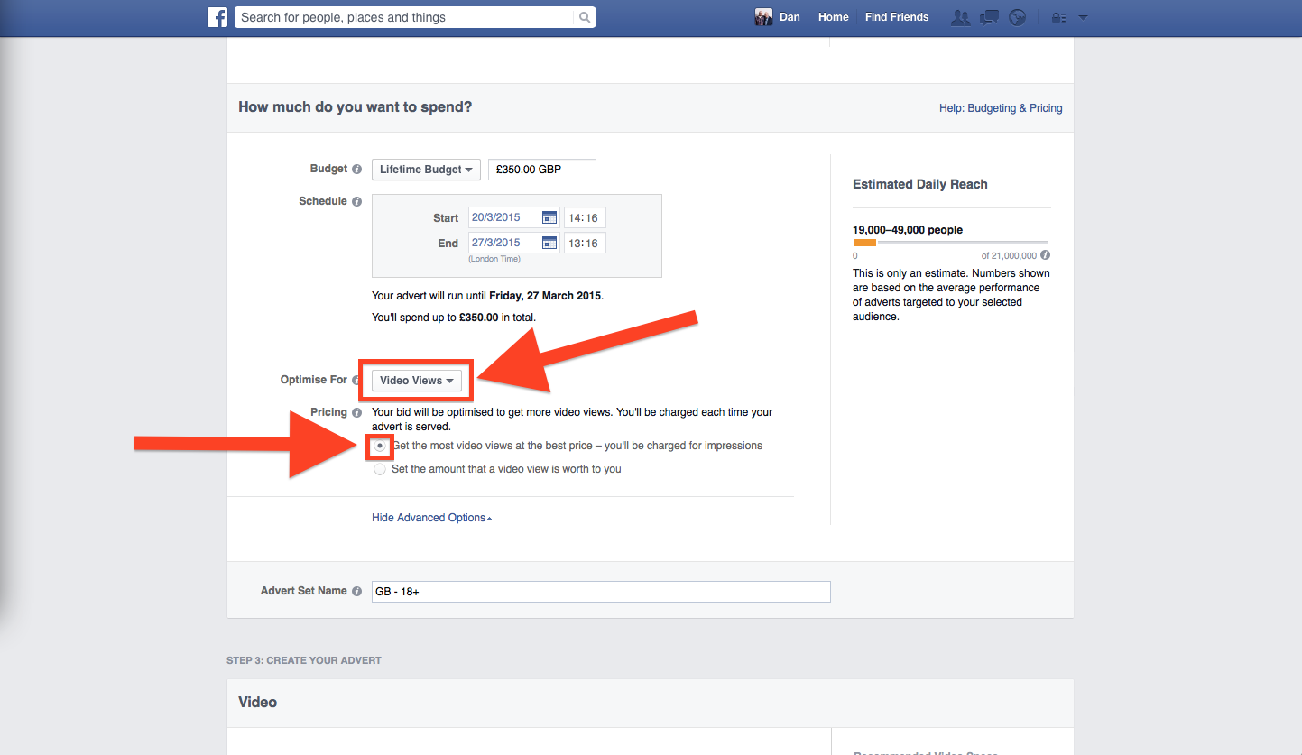
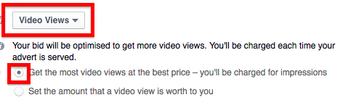
How to Create a Video Ad
Bidding
Optimise for Video Views
Select Get the most video views at the best price

Slide 60
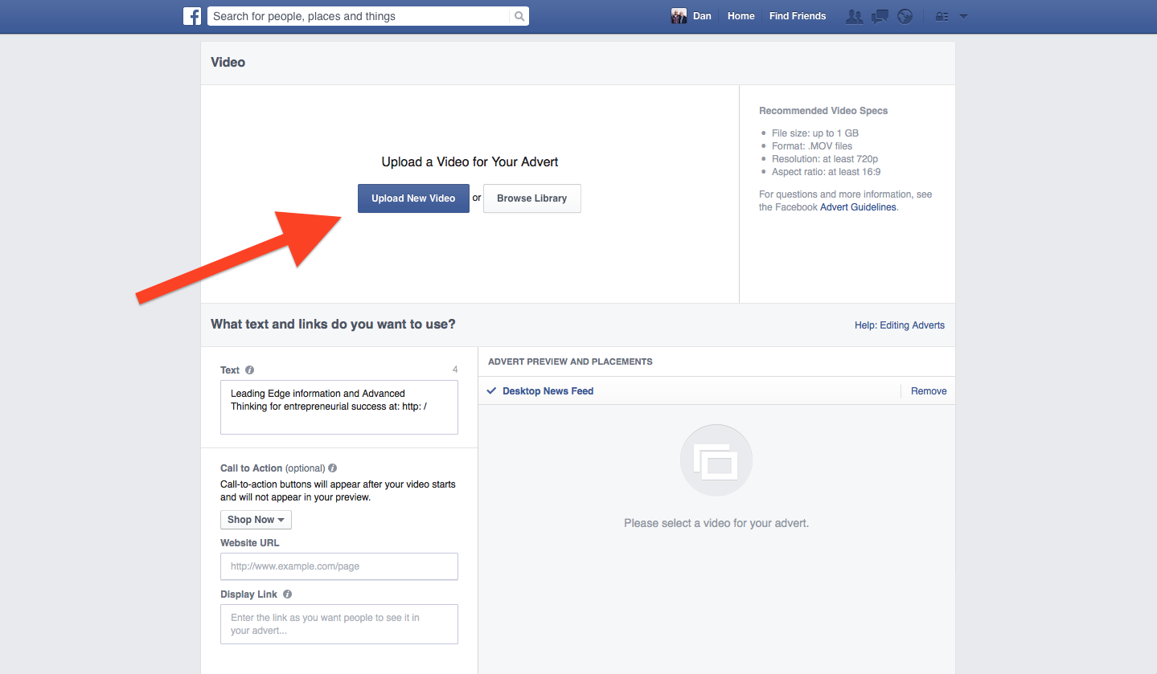

How to Create a Video Ad
Video
Click Upload New Video
Videos must be in .MOV format
Maximum file size is 1GB (most videos will be fine)

Slide 61
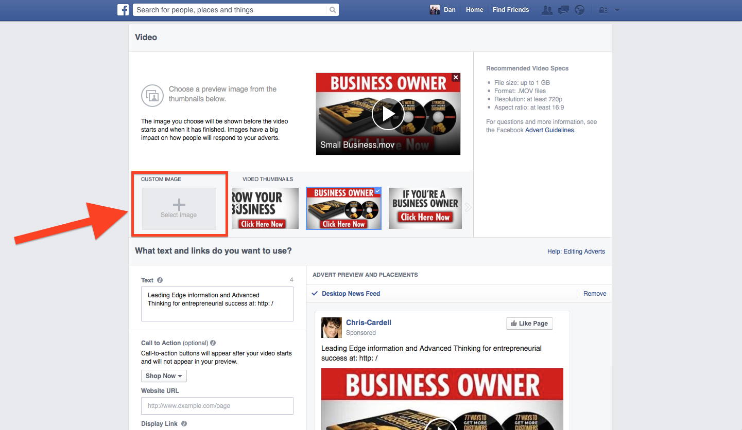
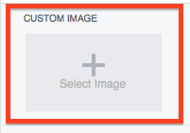
How to Create a Video Ad
Thumbnail
Select a video thumbnail (this will be shown before your video starts and when it ends)
Or upload your own
The ‘no more than 20% text’ rule applies to video thumbnails

Slide 62
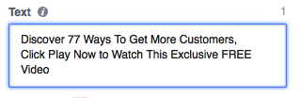
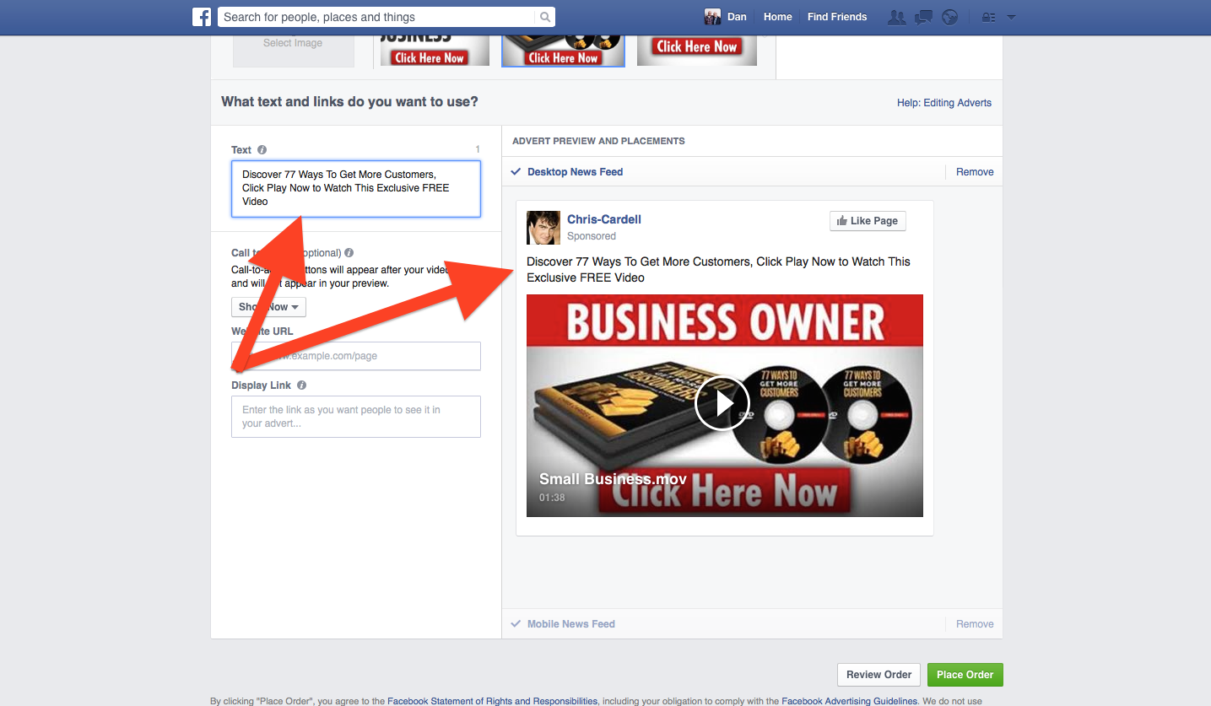
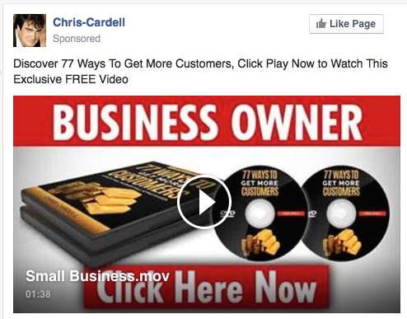
How to Create a Video Ad
Text
Add your text to appear above the thumbnail

Slide 63
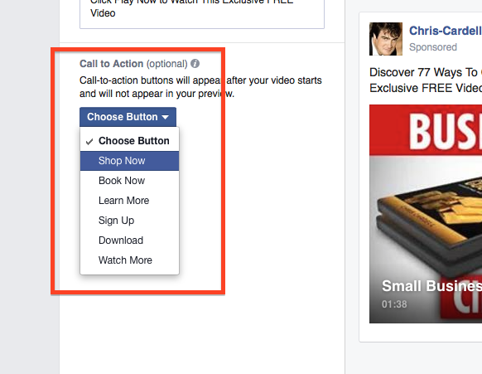
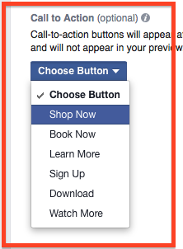
How to Create a Video Ad
Call to Action
Add a Call to Action button. Choose from:
Shop Now
Book Now
Learn More
Sign up
Download
Watch More

Slide 64
How to Create a Video Ad
Call to Action
Buttons appear top right of the video
A Call to Action link appears on the screen at the end of your video

Slide 65
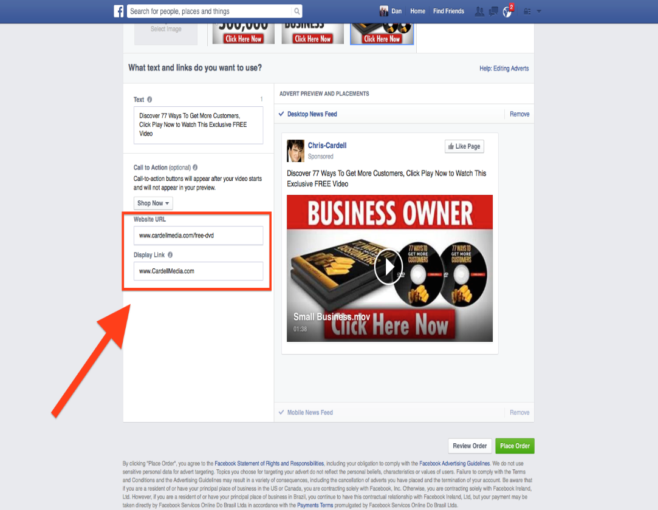
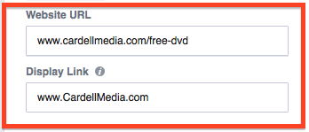
How to Create a Video Ad
Call to Action
Enter a website URL
Enter a display URL

Slide 66
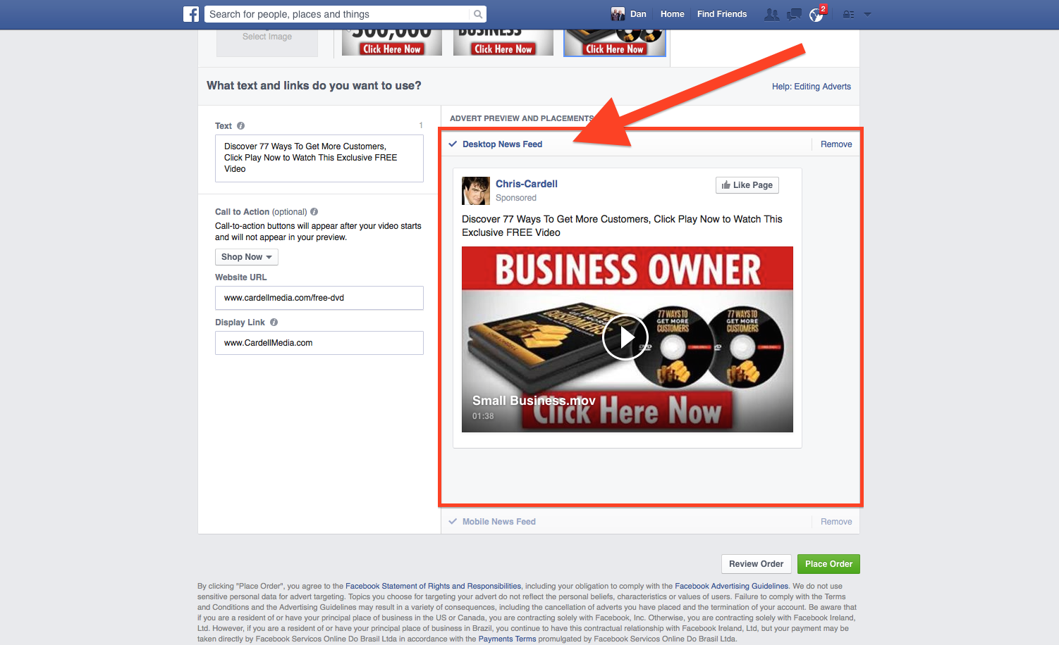
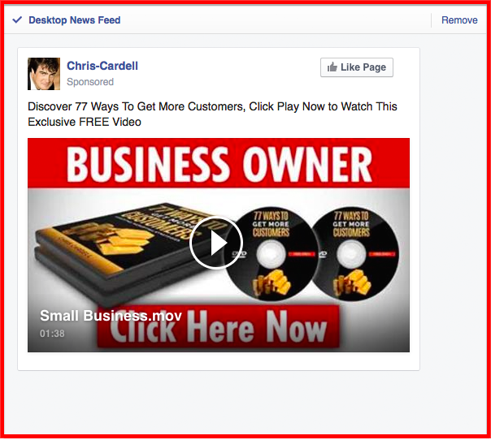
How to Create a Video Ad
Preview and Placement
Select / Remove Desktop News Feed

Slide 67
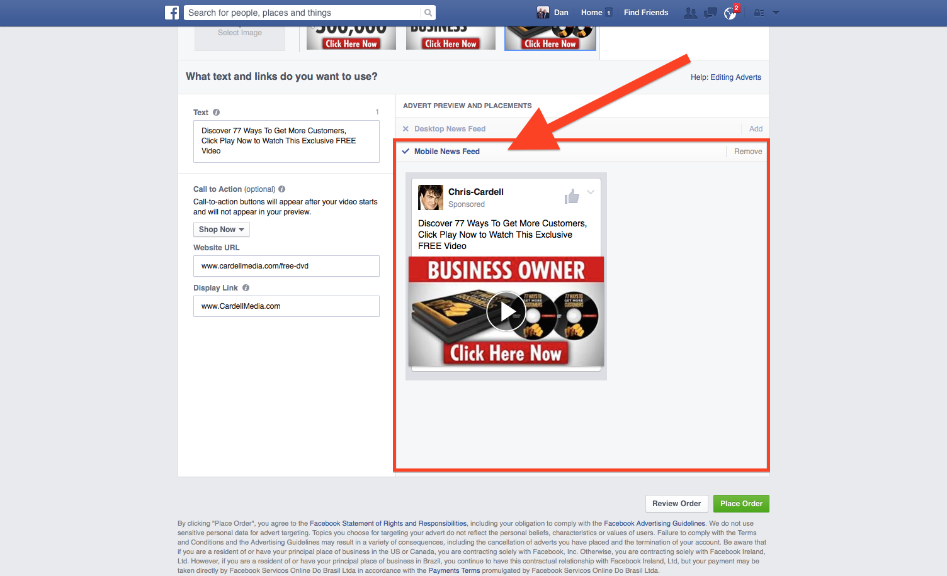
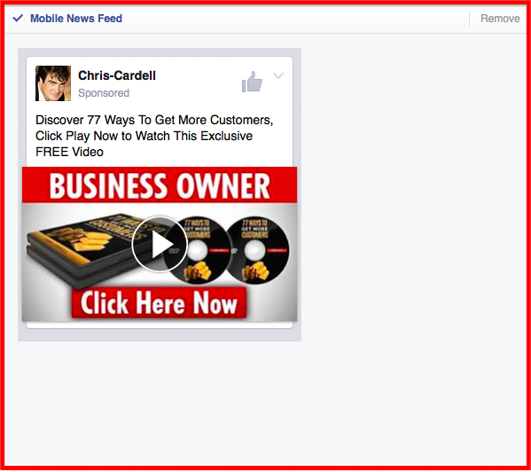
How to Create a Video Ad
Preview and Placement
Select / Remove Mobile News Feed

Slide 68


Slide 69

YouTube
1 Billion mobile video views per day
Half of YouTube views are on mobile devices
Mobile revenue on YouTube is up over 100% y/y

Slide 70
The YouTube Opportunity
YouTube is the world’s second largest search engine after Google
More people search YouTube than Yahoo and Bing COMBINED
93% of active internet users have watched a YouTube video in the last week

Slide 71
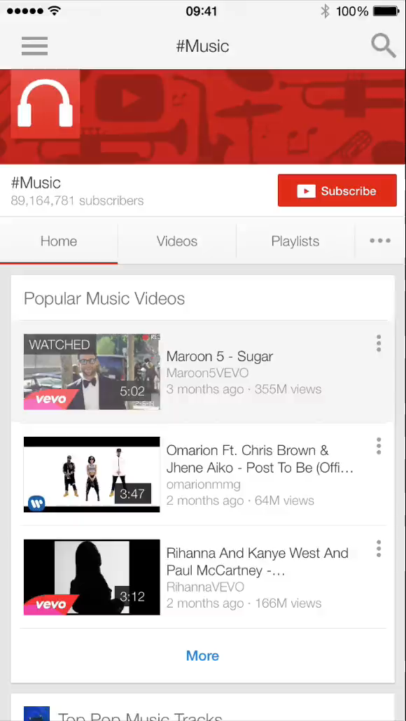
Permission Advertising
YouTube Your video ad appears before the videos people watch on YouTube
People can choose to skip your Ad

Slide 72
Permission Advertising
You want to encourage people NOT
to watch your video
Reverse psychology: goes against everything we’ve been told

Slide 73
Laser-Like Targeting: TV Advertising Direct to Your Customers
Target people based on who they are, where they’re located and what they’re interested in
For example, men aged 35-45 in Leeds
who enjoy going fishing at the weekends

Slide 74
Targeting Options
Demographics
Reach people by their age and/or gender

Slide 75
Targeting Options
Interests
Reach people based on their personal interests…
Pet Lovers
Car Enthusiasts
Healthy Eating Enthusiasts
Fitness Videos
Wedding Planning
Travel Enthusiasts
How To Videos
Documentaries
And much more…

Slide 76
Keywords
You can use your existing keywords from your AdWords account

Slide 77
Topics
Reach people based on the types of videos they enjoy watching on YouTube
Every video on YouTube is categorised into topics, so you can find people based on the topics they like to watch

Slide 78
Placement
Target specific videos on YouTube and specific websites on the Google Display network (even your competitors videos on YouTube)

Slide 79
Remarketing
You can use your regular AdWords Remarketing pixel to target people who visited specific pages of your website
YouTube will automatically start to build you a Remarketing list based on your viewers behaviour – you can then use this to target people who have watched your content

Slide 80
In-Stream
In-stream ads are clickable
Can be linked to your own website
/ landing pages
Perfect for Direct Response Marketing

Slide 81
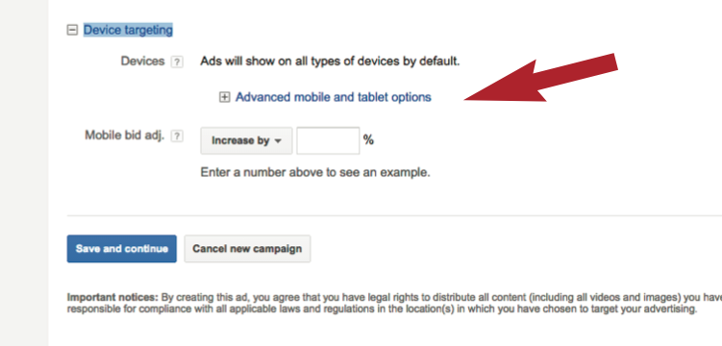
YouTube
To target Mobile devices specifically, login to your Adwords for Video Campaign and increase the Mobile bid by 100%

Slide 82

Google Search
48% of searches are on mobile devices
You should make sure your address and directions appear in your ads
Ensure your business is on Google Places www.google.com/business

Slide 83
Google AdWords
Mobile optimised websites with mobile targeted campaigns get 11.5% higher CTR’s on average
Have a ‘Clickable’ phone number on your landing page – make it as easy as possible for people to reach you

Slide 84
Google AdWords
Enable Ad Extensions across your campaigns
Use action-oriented keywords to help users make a decision quickly. Broad match keywords perform well on mobile
Incentivize mobile searchers with offers and calls to action that speak specifically to mobile users

Slide 85

Yahoo
The Yahoo Gemini mobile search and native ad network
550 million monthly users
Offers location, gender, age and interest targeting
Go to www.gemini.yahoo.com

Slide 86
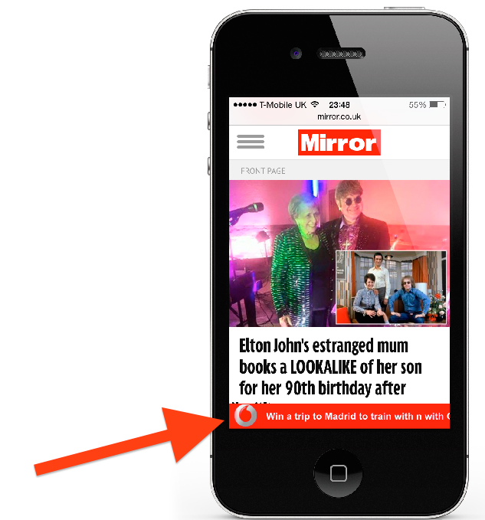
Display
Full-screen ads have a higher CPC, but tend to have a higher click-through rate
Full-screen ads appear as someone transitions between screens in an app
Banner ads appear across the top of an app page or screen

Slide 87
Order Forms and Conversions

Slide 88
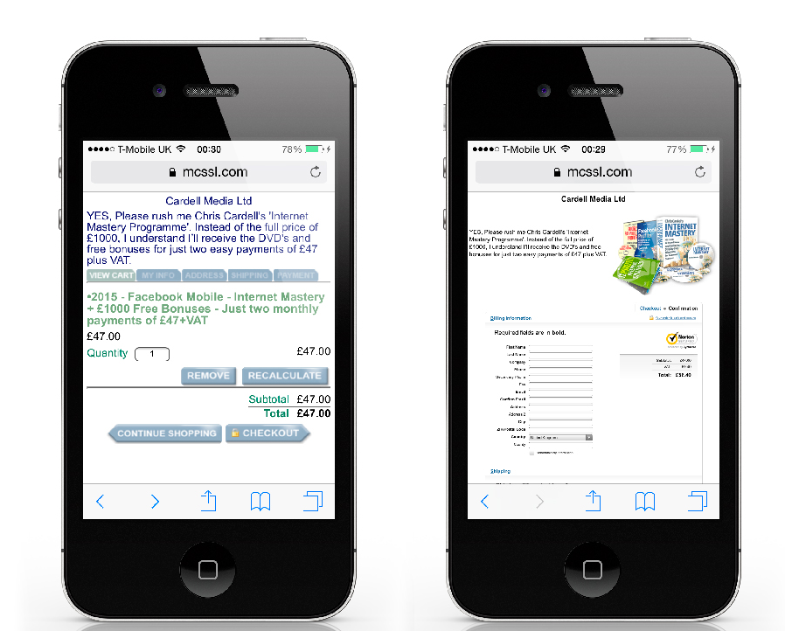
Order Forms and Conversions
Test optimised forms vs. regular order forms
Treat mobile and tablets differently

Slide 89
Order Forms and Conversions
Screens are smaller, so text entry is more tedious. Where possible, use:
Checkboxes
Radio buttons
Select menus
and lists
Regular forms are performing better on both mobile and tablets

Slide 90
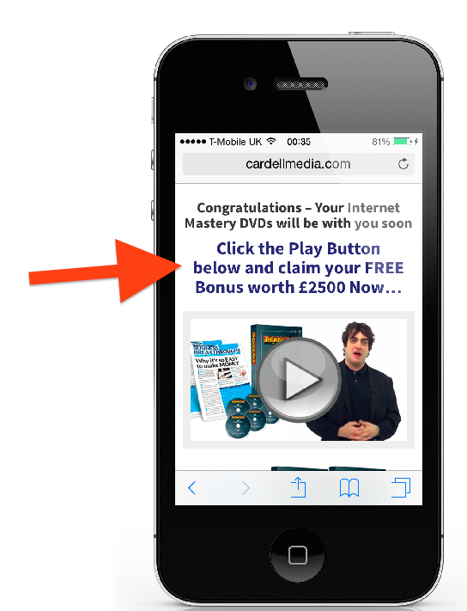
Order Forms and Conversions
From our testing:
Keep text entry to a minimum, don’t ask for billing address AND delivery address
Upsells work well on mobile - but you need a headline prompting people to click ‘play’ on your video

Slide 91
Advice
Test using www.stripe.com for mobile payments
We use www.1shoppingcart.com
Track your cart abandonment rate using www.paditrack.com or www.mixpanel.com

Slide 92
Text Marketing

Slide 93
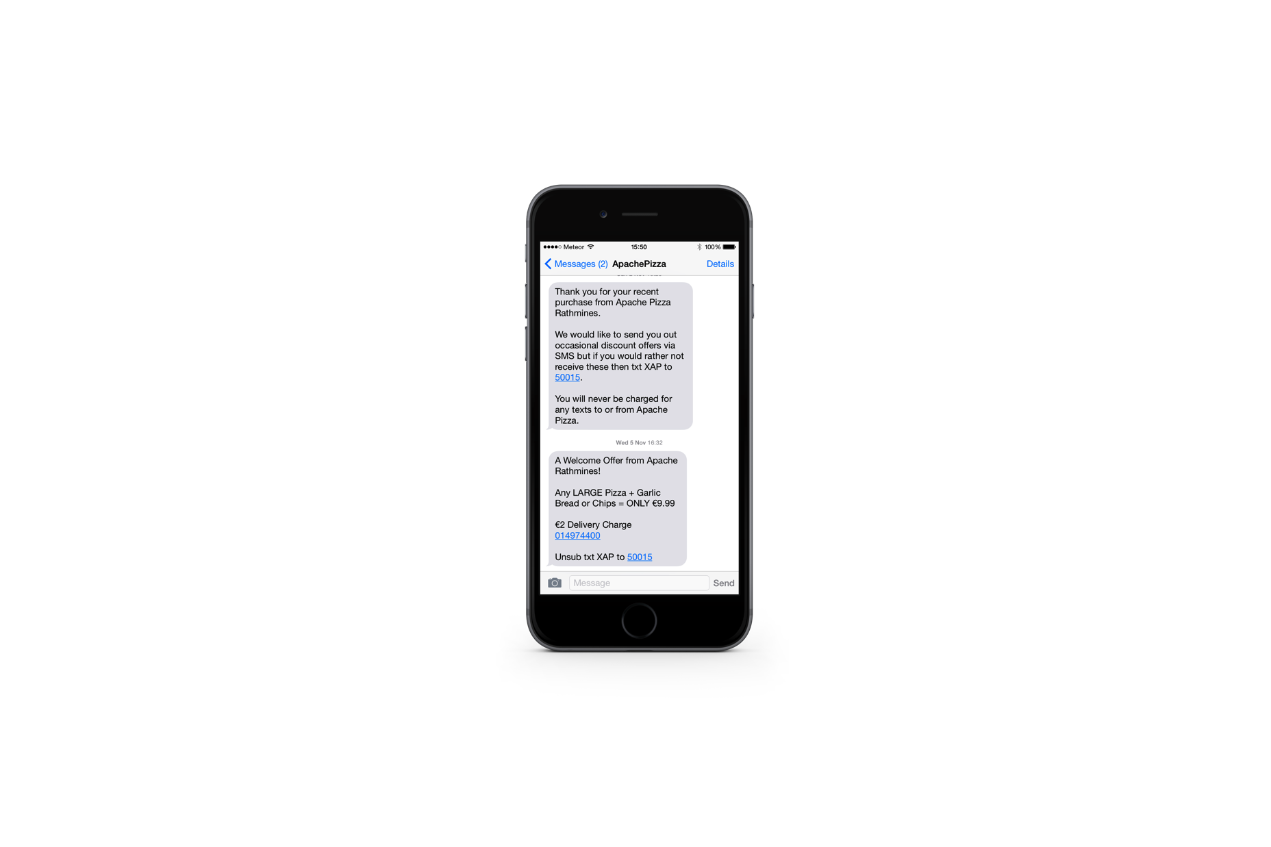
Text Marketing
10% to 20% of Emails are read
90% plus of texts are read
Use with caution
Good for providing information
Good for major announcements
Can be used for sales deadlines (sparingly)

Slide 94
Text Marketing
Text Broadcasts – www.Voicescape.co.uk

